Slide 1
Elements of Risk Assessment and Risk Profiles
Unit 3B
Risk Analysis in Safety Engineering
Fall 2022

Slide 2
References
Modarres, M., Risk Analysis in Engineering, Taylor & Francis, 2006, Chapter 2 (Modarres, RAE)
Norman Fenton and Martin Neil, “Risk Assessment and Decision Analysis with Bayesian Networks, 2nd ed.” CRC Press, 2019 (RDBN, 2019)
Pasman, Hans J., Risk Analysis and Control for Industrial Processes-Gas, Oil and Chemicals: A System Perspective for Assessing and Avoiding Low-Probability, High-Consequence Events, Elsevier, 2015
Modarres, M., M. Kaminskiy, V. Krivtsov, Reliability Engineering and Risk Analysis, 2nd ed, Taylor & Francis, 2010, Chapter 1 (Modarres, RERA)
Jordaan, Ian, Decisions Under Uncertainty– Probabilistic Analysis for Engineering Decisions, Cambridge University Press, 2005 (Jordaan, 2005)
Ayyub, B.M., Risk Analysis in Engineering and Economics, Chapman & Hall/CRC, 2003 (Ayyub, RAEE)
Kumamoto, H., Satisfying Safety Goals by Probabilistic Risk Assessment, Springer, 2007 (Kumamoto, 2007)
Judea Pearl, The Book of Why, Basic Books, New York, 2018 (Pearl, 2018)

Slide 3
Risk Assessment of Compressed Natural Gas (CNG) Fuel Refueling Station and Bus System
A Case Study
Chamberlain, S. and Modarres, M., Risk Analysis of Compressed Natural Gas School Buses, Risk Analysis, 25(2), 2005
Preparation for Team Projects

Slide 4
Review: Steps in Risk Assessment
Hazard Identification
Natural/artificial hazards
Sources, amount, intensity
Active/passive
Contain, remove, neutralize
Prevent, mitigate, control
Barrier Identification
Barrier Performance
Assessment
Test and monitor for Success/fail
Cause of failure
Act independently
Probability Assessment
Identify exposure path
Frequency of exposure
Amount of hazard released
Characteristics of hazards
Potential recipients
Consequences of exposure
Exposure Assessment
Risk Characterization
Calculate risk value, range, distribution

Slide 5
Example Risk Assessment CNG Fuel Supply and Refueling Station
Compressed natural gas (CNG, ~ 95% methane) System: buses and bus filling station
Subsystems:
Natural gas supply
Compression and storage station
Dispensing facility
CNG bus
Operator interactions with equipment, maintenance involving Human and Organizational factors
What are the expected hazards?
^Chamberlain, S. and Modarres, M., Risk analysis of compressed natural gas school buses, Risk Analysis, 25(2), 2005

Slide 6
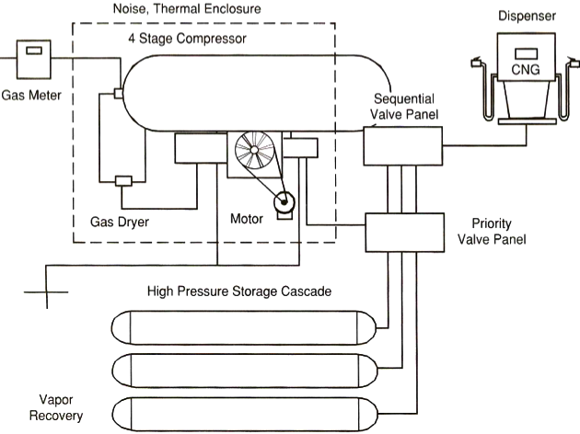
CNG Refueling Station
NG
Valves fittings
3000 psig
High pressure
Modarres RERA, Fig 8.3

Slide 7
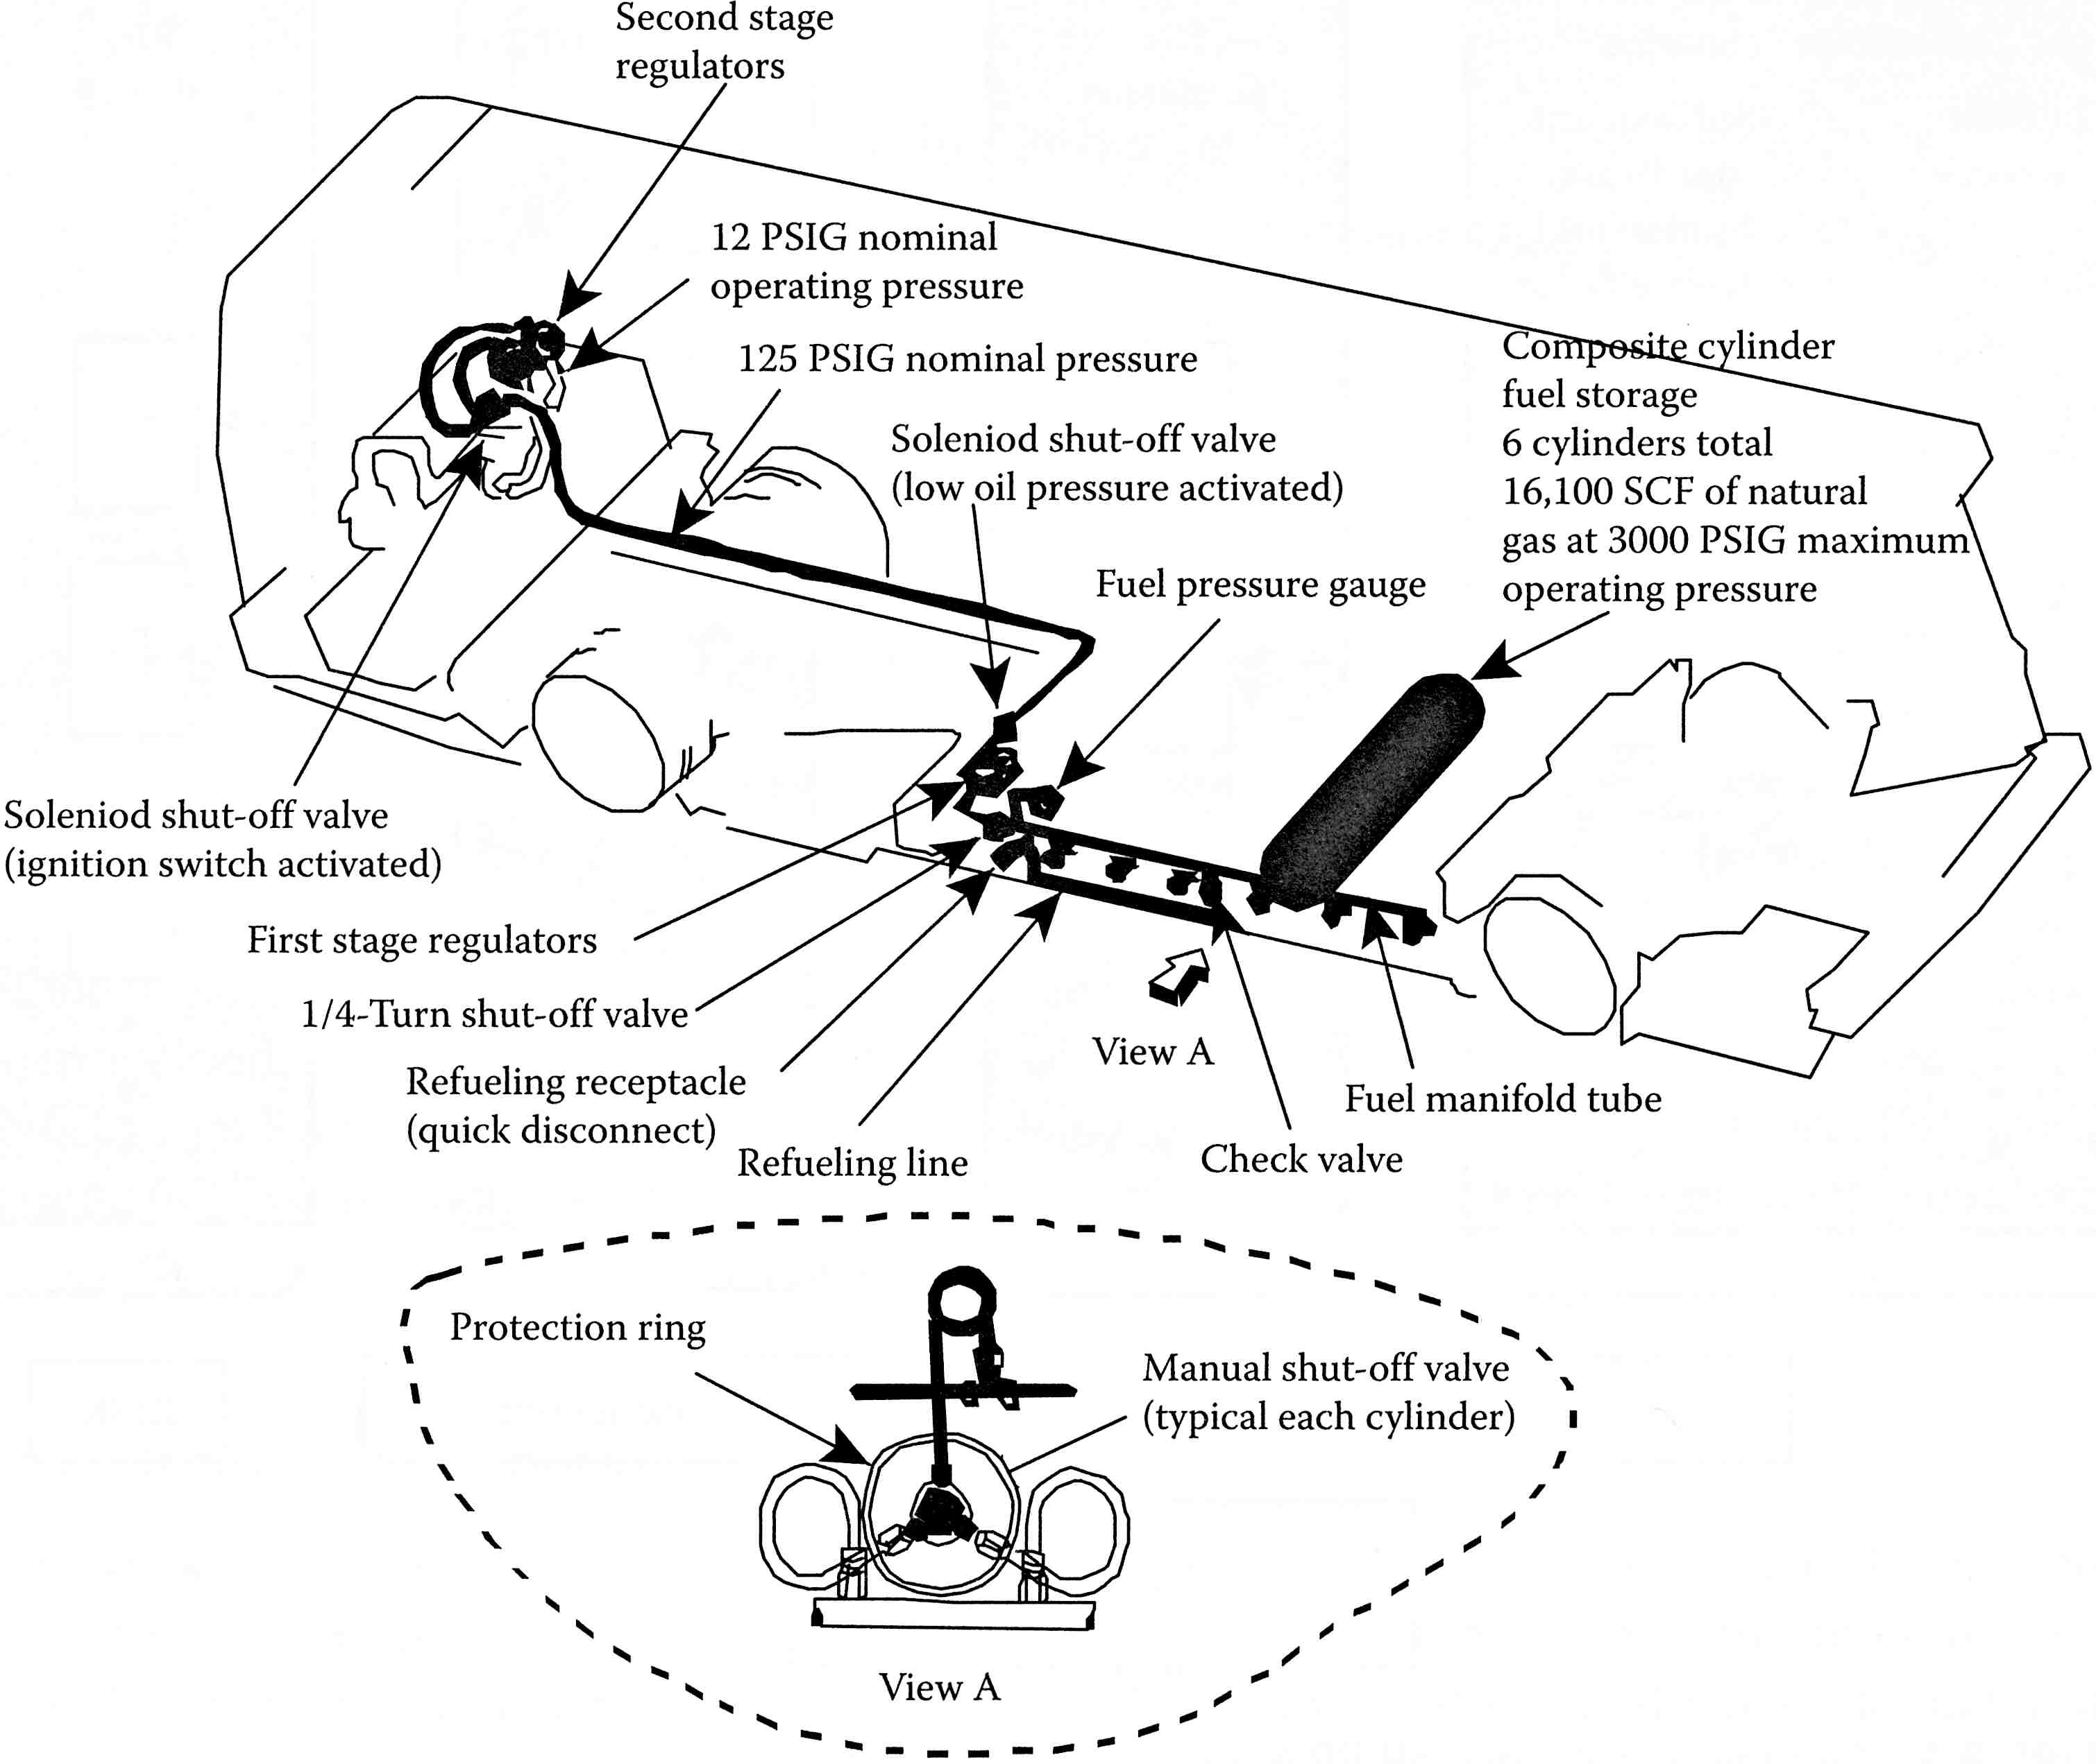
CNG Bus Fuel Supply System
High pressure regulated to 12 psig on buses
Asphyxiation, fire explosion
Lacking on bus is a Natural gas detector!
Organizational deficiency: Management (training, auditing, enforcement), Inspection, Maintenance
Valves fittings
leaks
Modarres RERA, Fig 8.4

Slide 8
RA Components, STS Organizational Factors
1 | Hazards | Natural gas/methane fire and explosions; asphyxiation on buses
2 | Barriers | Integrity of storage tanks, pressure control, gas detectors, operators, maintenance
3 | Barrier performance | Scenarios: failure of barriers and effects, e.g., mechanical, chemical, electrical induced failure, operator error
4 | Exposure | Gas released and dispersed, igniting fire, fatalities due to fire
5 | Risk characterization | Severity and probability or frequency distribution of occurrence of each credible failure scenario
What can go wrong
Consequences
How likely

Slide 9
Hazards of the System
Fire potential from fuel leakage
Explosion potential from uncontrolled dispersion and mixing of CNG in the presence of an ignition source
Impact and missile-generated hazards due to fuel being stored at high pressure
Chemical hazards (gas toxicity, asphyxiation etc.)
Electrostatic discharge
Gas is stored at high pressure. Storage system susceptible to corrosion fatigue, stress corrosion, cracking etc.

Slide 10
Semi-Quantitative Risk Assessment
Various scenarios can arise from each hazard
Generally a qualitative or semi-quantitative approach is taken to reduce the number of scenarios and bring focus to the critical ones for a quantitative risk assessment
FMEA (Failure Mode and Effect Analysis) is one method to identify important failure modes and subsequent effect leading to CNG fire and explosion
A qualitative measure of each failure mode was provided in terms of its frequency of occurrence and probable outcomes to determine the importance

Slide 11
Semi-Quantitative RA for CNG System
Relative Frequencies for Fire Scenarios
Severity Categories of Fire Exposure (quantify the levels)
Frequency | Likelihood to occur
Frequent | 1 year or less
Probable | 10 years or less
Unlikely | 20 years or less
Remote | > 20 years
Catastrophic | CNG released with catastrophic fire & explosion
Critical | Unconfined CNG releases, critical fire/explosion
Marginal | Small CNG released with small fire effects
Minor | Failure with minor fire potential; only loss of system operation

Slide 12
Semi-Quant Risk Matrix for Fire Scenario with no. of scenarios identified in each risk category
 | Catastrophic | Critical | Marginal | Minor
Likely | 5 | 9 | 5 | 10
Probable | 1 | 8 | 6 | 15
Unlikely | 3 | 7 | 12 | 19
Remote | 4 | 3 | 2 | 3
Upper left quadrant scenarios have significant risk levels that require risk reduction, mitigation, and strategies (and hence are considered further for quantitative risk assessment)
Lower right quadrant scenarios show less significant risks (but that does not mean the risk is not there!)

Slide 13
CNG Hazard Barriers
With hazards and scenarios identified, we next look at what barriers we have:
CNG storage tanks
Pressure control systems (3,000 regulated to 12 psig)
Gas detectors
Warning indicators
Operators, training
Maintenance, testing
Management: training, auditing, enforcement
Reliability and Maintainability analysis
Operational, procedural hazard barriers
Human reliability contribution to risk

Slide 14
CNG Barrier Failure, Examples
Example failure scenarios internal or external to the barriers:
Failure Type Internal Failures External Failures
Mechanical Falling CNG tank Projectiles
Fuel leak Gas pipe fire
Chemical Tank explosion Corrosion, fire
Electrical Vehicle fire Electrostatic, fire
Organizational
Procedure, Training, Spare part supply delays

Slide 15
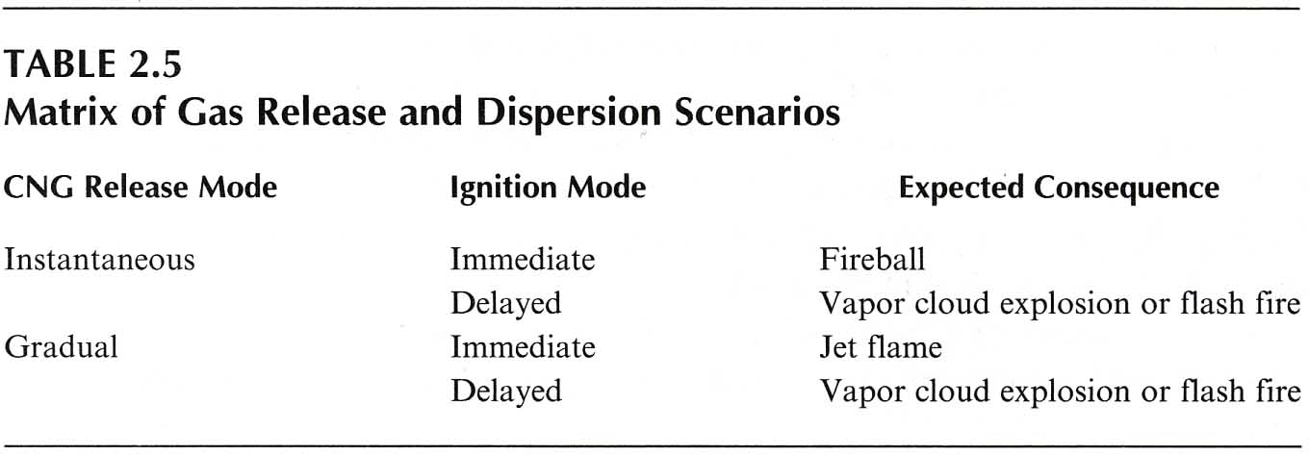
CNG Fire Scenarios
Scenario characteristics from barrier failures leading to outcome events
< 10 min
> 10 min
Gas collected in confined space of a bus, asphyxiation, ignite, explode
(Modarres RAE, Tab 2.5; Modarres, RERA, Tab 8.3)

Slide 16
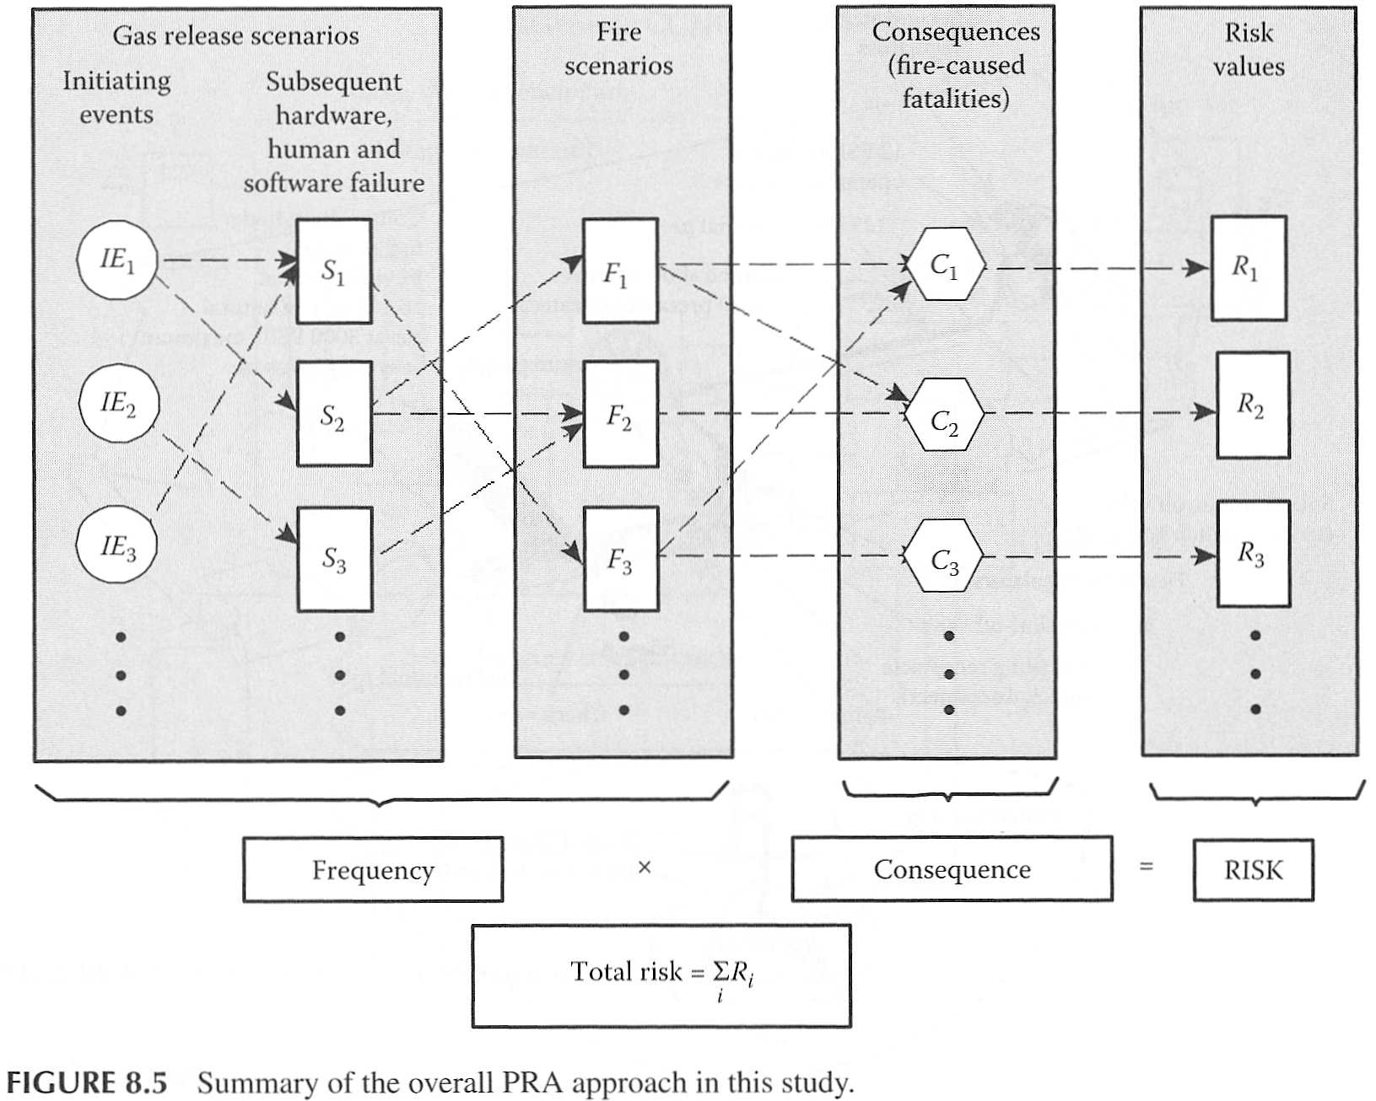
Analyze all Credible Scenarios, IEs, and Outcomes
(Modarres RERA)

Slide 17
Quantitative Risk Assessment (QRA): CNG, Fire Scenario Event Tree
Risk (S_{j}) = Freq of a barrier failure, f, (initiation)
x P(gas release | barrier failure)
x P(expansion and ignition | gas release)
x P(a particular fire dispersion | gas ignition)
x P(a particular fire type | the particular dispersion)
x P(fire | a specific location)
x Consequence severity for a particular scenario outcome, C_{S}
Risk (S_{j}) =
Conditional Probabilities
(assumes independent P_{i})
Risk neutral, β = 1
= Frequency x Consequence
Frequency

Slide 18
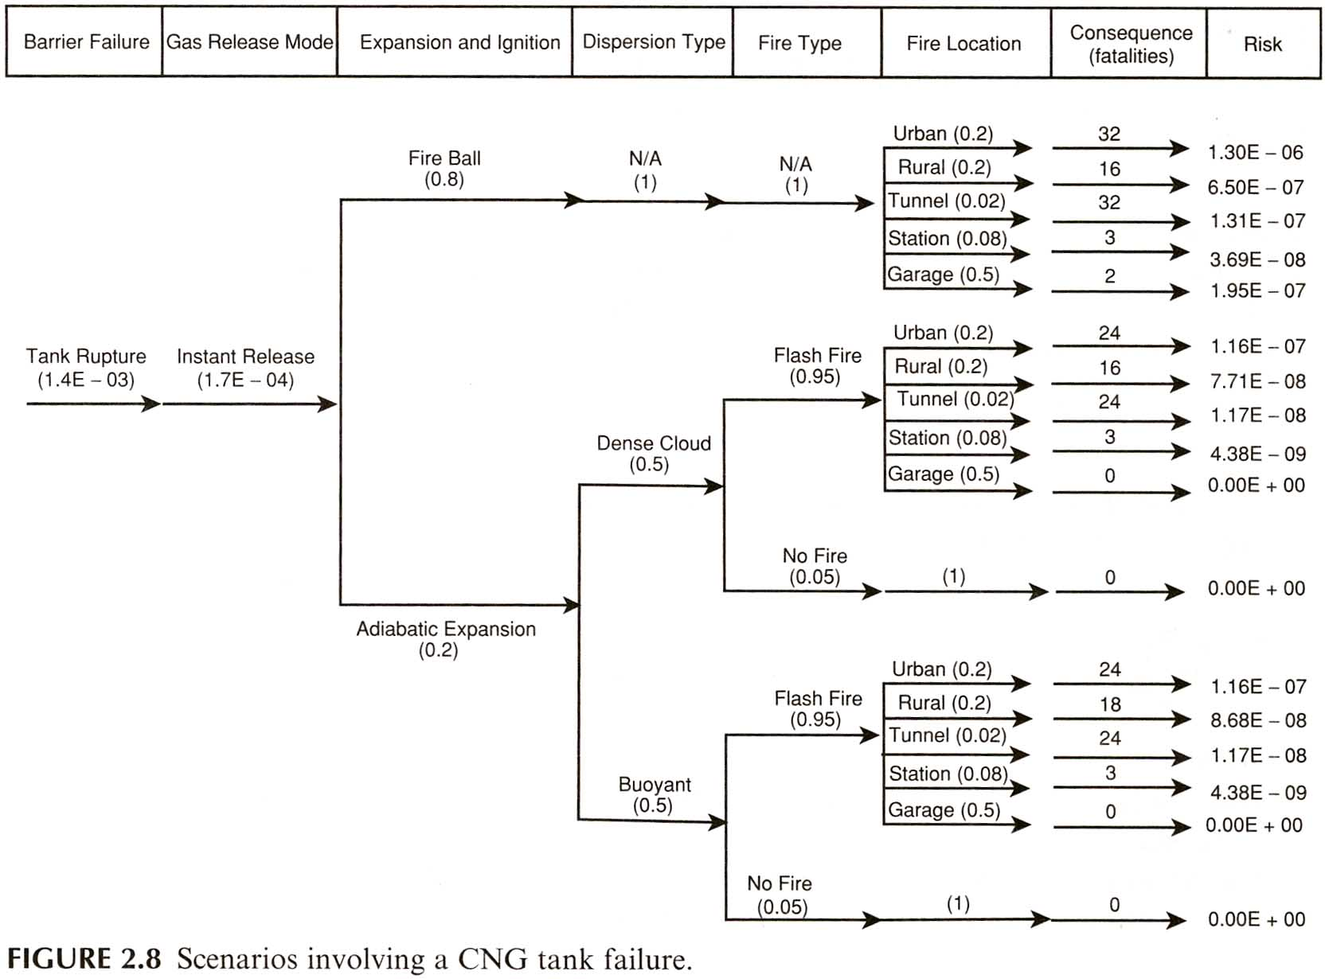
f∙P∙C
/yr
Values based on previous events.
Initiating Event (IE): CNG tank failure
f
#/year
probability
near ground
Event tree of CNG scenarios from an IE
above ground
(Modarres RAE)

Slide 19
CNG Uncertainty Analysis & Propagation
Sources of uncertainty in this case study:
Generic bus system description and model
Completeness in the fire hazard scenarios
Assumptions used in the fire scenarios and consequence distribution modeling
Hardware and human failure data
Estimated frequency distributions of fires and locations
Integration of scenarios for total risk distributions
Model uncertainty
Organizational Factors: Resilient Leadership, Effective Management, Safety Culture

Slide 20
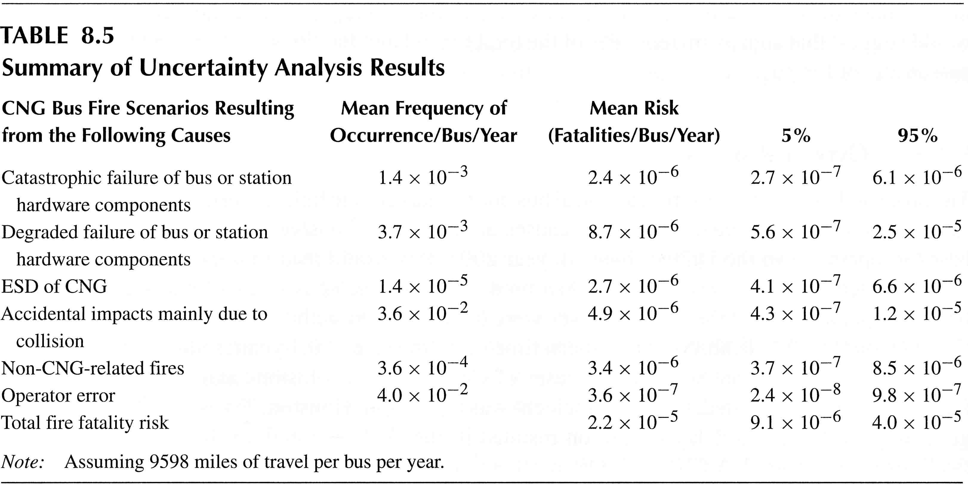
Analysis of CNG Data Uncertainty Propagation
Uncertainty analyzed here is mainly uncertainty of the failure data.
Modarres RERA
^CL Confidence limits
11x10⁻⁶
Model uncertainties were reduced through independent peer reviews.
^CLs of confidence intervals with data epistemic uncertainty for validiation.

Slide 21
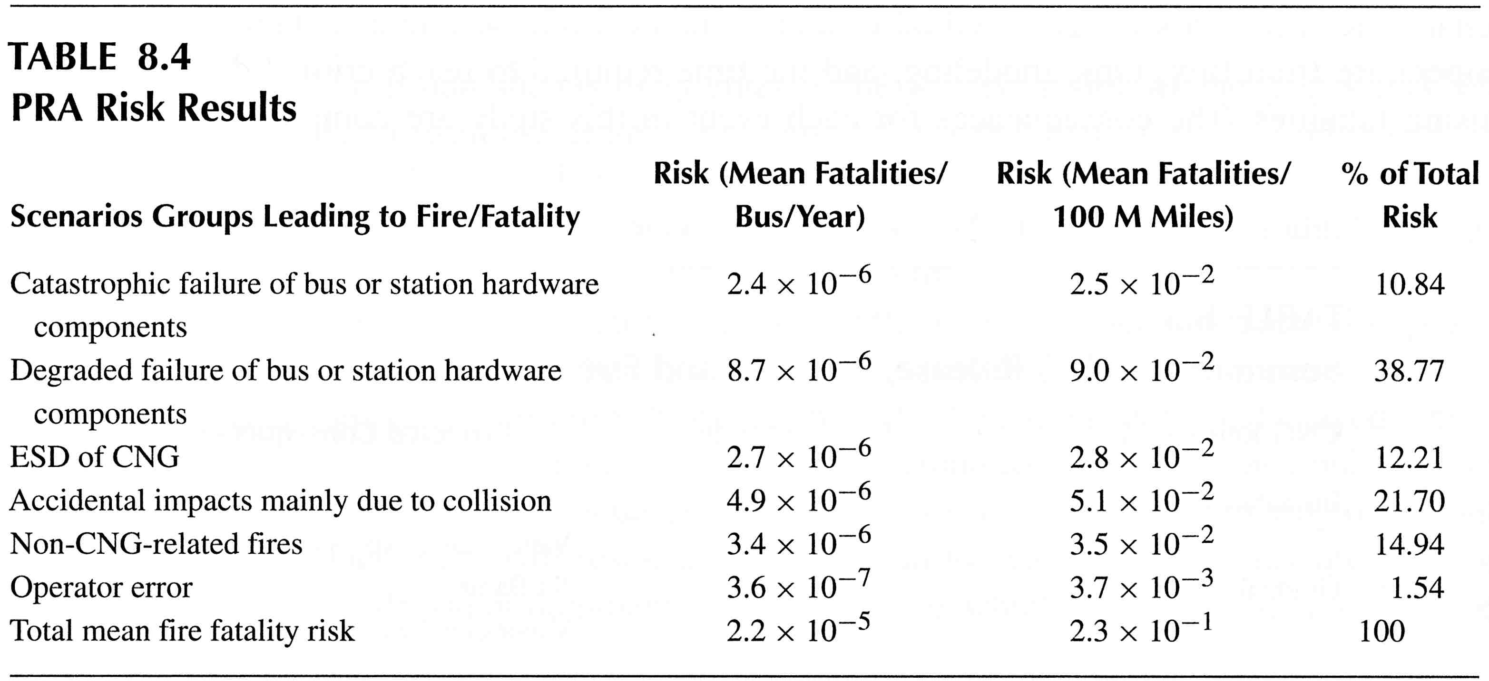
QRA Fire Safety Risk Summary
Categorize causes or contributors to the overall risk
Risk contributors
Bus + Station
Cause scenarios:
Modarres RERA

Slide 22
CNG Mortality Risk Assessment
Fire risk assessment of compressed natural gas school bus and fueling infrastructure
Risk Sources: largest were from failure rates of pressure relief valves, CNG cylinders, and fuel piping.
Reduce risk to tolerable level: focus on critical components that contribute most to risk level
Reliability, Maintainability
Testing, maintenance: A high priority on tests and maintainability is required for this system because of high pressure and high combustibility.
Organizational Factors: Training, retraining, and testing for personnel
(Chamberlain, 2005)

Slide 23
CNG Compared to Diesel: Risk-Based Decision Making
Diesel school bus risk from historic data
Mean fire fatality risk for all people and for bus passengers only per 10⁸ miles:
Technology Bus + Station Bus only CNG 0.23 0.16 Diesel 0.091 0.0007
2.5x
> 200x
Note that CNG buses and bus stations are exposed to ~ 2.5 times more than mean risk, and bus passengers exposed to > 200 times more mean risk compared to diesel buses.
(Chamberlain, 2005)

Slide 24
Limitation of this Risk Assessment
This CNG System Risk Assessment is focused mostly on the technical engineering system, but it could be a more comprehensive analysis of a socio-technical system (STS) and include analysis of human and organizational factors.
Human and Organizational Factors play a critical role in risk assessment and risk management, because individual and team-work human behavior and reliability and the technical system availability of operations are interdependent throughout an organization.
A System (or Systems) approach for a complex STS, includes modeling, measuring, monitoring, updating, and managing with leadership an engineering system within its organization.

Slide 25
Things to think about!
State why there is greater risk for CNG technology compared to risk for diesel technology.
State why risk is greater for bus passengers compared to risk for people outside the bus involved in bus incidents.
Ways to lower and manage CNG fire risk: Recall ~40% of the fatality risk is associated with bus and station hardware failure.
Compare the CNG with a LNG (liquid natural gas) system and discuss what information is needed to make a decision between them.

Slide 26
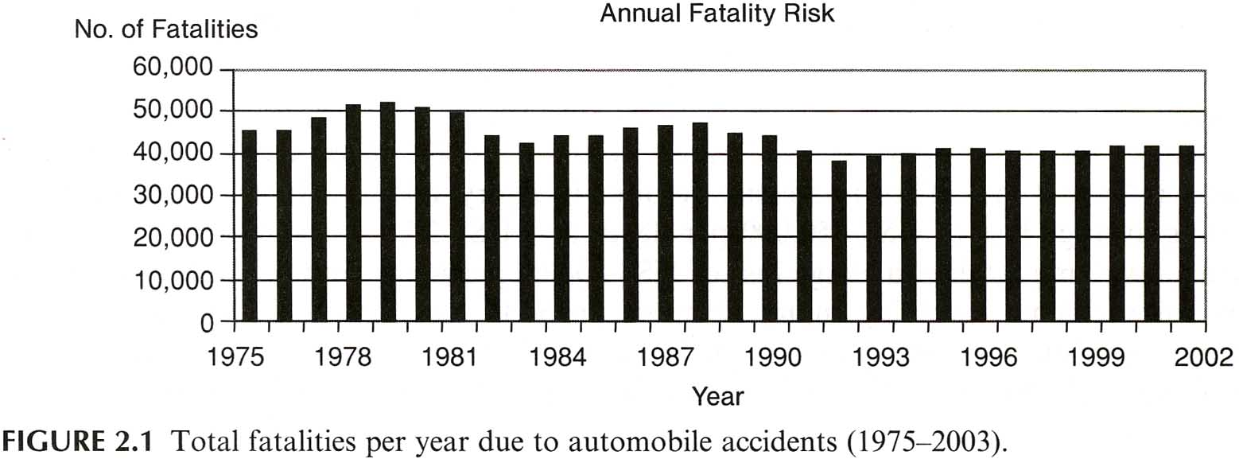
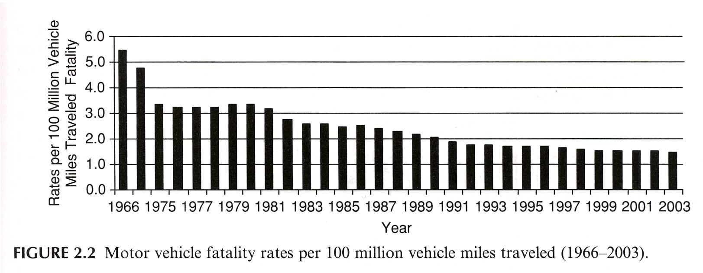
Risk in different units to identify contributors to the risk
Automobile fatality over 27 years:
Risk ~ stable.
Normalized Automobile Fatality:
Risk over distance is reduced.
(Modarres RAE)
Causes: # cars, better roads, safer cars, trained drivers

Slide 27
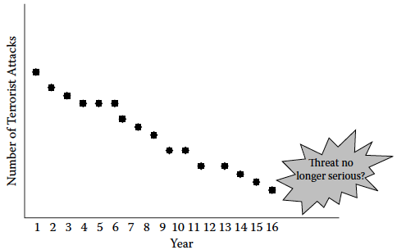
Do the Data Tell the Full Story? Causal Inference
Increased confidence that threat is greatly reduced can engender complacency
Cause/effect of security measures are not considered in this model.
Seek causes of trend
Data on terrorist attacks interpreted by statistical methods predicts a reduction of 15% in attacks from Years 16 to 17 and a sufficiently low threat. Confidence in an incomplete model (causes not known) and extrapolation beyond the data, can result in reduction of security measures due to perception of a negligible threat.
This decreasing trend in the data could be influenced by increasingly effective counterterrorist measures rather than a reduction in the threat.
Search for Hidden Causes, influences to guide prediction.
(RDBN, 2019, Ch 1, p. 25)

Slide 28
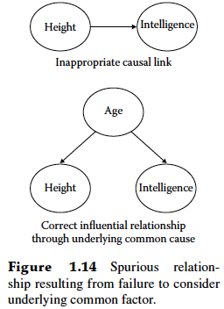
Seek Causes From Correlations
Cause
Effect
Height, obscuring a common cause, is modeled as a cause or influence of Intelligence
Age is modeled here as a common cause of Height and Intelligence
Data have shown that body Height and Intelligence are highly correlated. Considering height as a primary cause for intelligence as shown in the left causal link between nodes Height and Intelligence misses the true (hidden) cause: Age.
Tests of models can reveal hidden causes or influences.
A Junction is a three-node network with two links between the nodes.
(RDBN, 2019, Fig. 2.15)

Slide 29
Seek Causes From Correlations or Associations
Fork Junction example:
Data have shown that Body Height and Reading Proficiency are highly associated or correlated with age.
Common Cause
Height Age Reading
This is a Fork Junction. B is the Confounder that influences both A and C and makes A and C statistically correlated even though there is no direct causal link between Body Height and Reading Proficiency.
((Pearl, 2018)

Slide 30
Seek Causes From Correlations or Associations
Chain Junction example:
This Junction is a Chain of three nodes. For this case smoke is the mechanism or mediator that transmits the effect of Fire to the Alarm.
Note that the Fire and the Alarm are conditionally independent given the Smoke (meaning that if there is no smoke, alarm does not depend on fire!).
Fire Smoke Alarm
(Pearl, 2018)

Slide 31
Seek Causes From Correlations or Associations
Collider Junction example:
Cancer can be caused by Toxic exposure and by Smoking
This is a Collider Junction with Cancer a Common Effect that due to each of two Causes.
This is also an example of Intercausal Reasoning to identify the most likely cause of a common effect based on the amount and quality of the evidence for each cause.
Types of Reasoning are Diagnostic (effect to cause) and Predictive (cause to effect)
Common Effect
Toxic Cancer Smoking
(Pearl, 2018)

